Slide 1





IFIP/IEEE International Conference on Very Large Scale Integration (VLSI-SoC 2024) Oct 6-9, 2024, Tanger, Morocco
Minimum Depth Quantum Modular Addition through Carry-Save Architecture
Authors
Siyi Wang¹, Eugene Lim¹, Xiufan Li², Jerrie Feng¹, and Anupam Chattopadhyay¹
Affiliations
1 Nanyang Technological University, Singapore.
2 Centre for Quantum Technologies, National University of Singapore, Singapore.
Email
Siyi002@e.ntu.edu.sg

Slide 2

01 Introduction
02 Research Question
03 Contribution
04 Method
05 Results
06 Conclusion
CONTENT

Slide 3


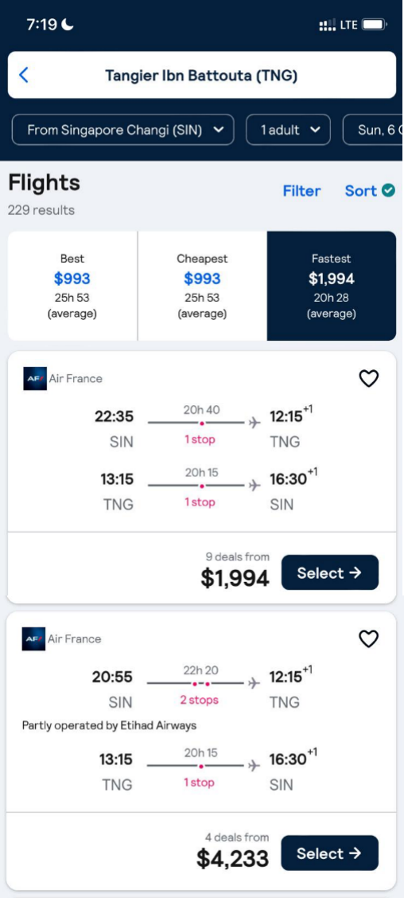
Introduction
Let’s Imagine...
It’s a normal day. Mr. David has just decided to buy a ticket to Tangier, Morocco, to attend the VLSI-SOC conference this year.
Unfortunately, he is unable to complete the payment because all the money in his account was stolen by a quantum attacker.
Mr. David is shocked. He immediately calls the bank manager...

Slide 4


Introduction
Public Key Encryption (RSA, ECC, ...)
Based on Hard Math Problems
RSA: Factoring large integers
High Security
Classical computers need several billion years to break.
Applications
Banking systems, secure communications......
Quantum Attack
Attack Private-key Encryption
Grover’s Algorithm, Simon’s Algorithm, ......
Attack Public Key Encryption
Shor’s Algorithm^{[1]}, ......
Shor's Algorithm
Finding the Prime Factors of an Integer
Attack Public Key Encryption
Capable of breaking public-key cryptography schemes.
Can break RSA in 8 hours with a powerful quantum computer.
High Resource Demand
Requires substantial qubits and quantum resources.
Most Resource-Intensive Component
Modular Exponentiation, which relies on modular addition.

Slide 5


Research Question
How to improve the efficiency of Quantum Modular Addition?

Slide 6
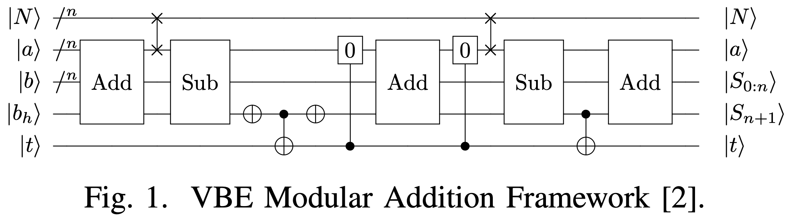
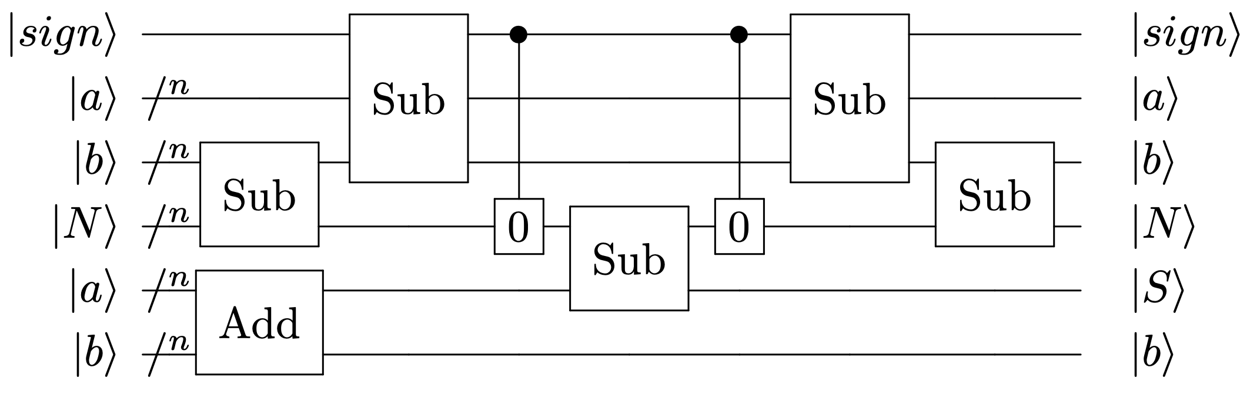
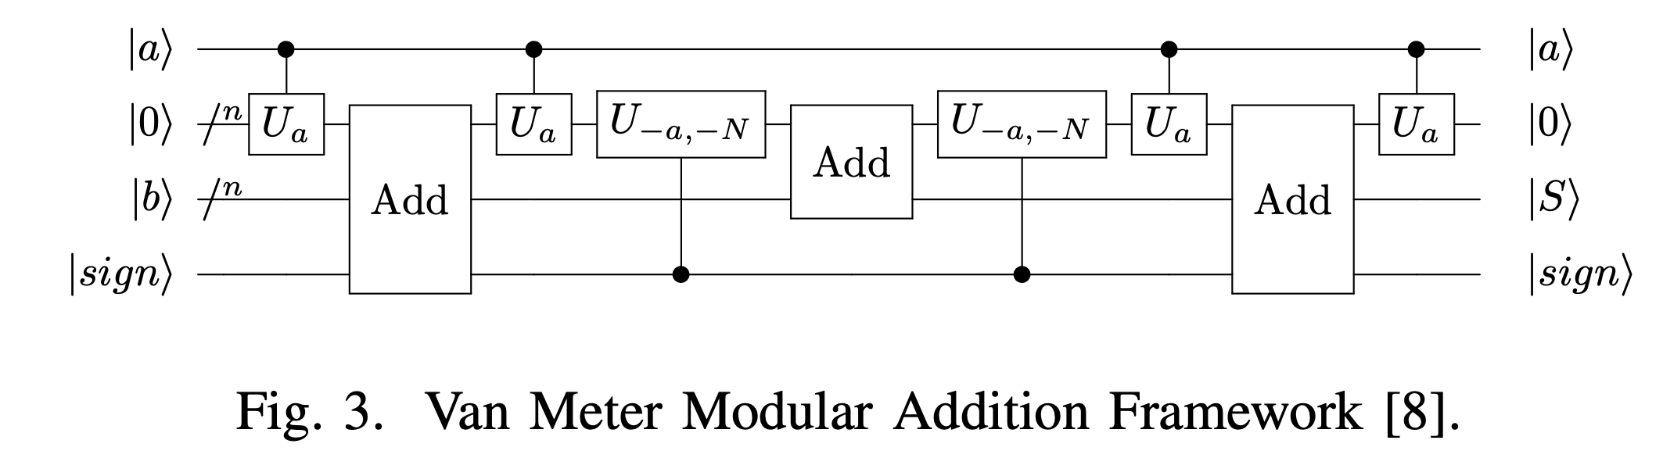
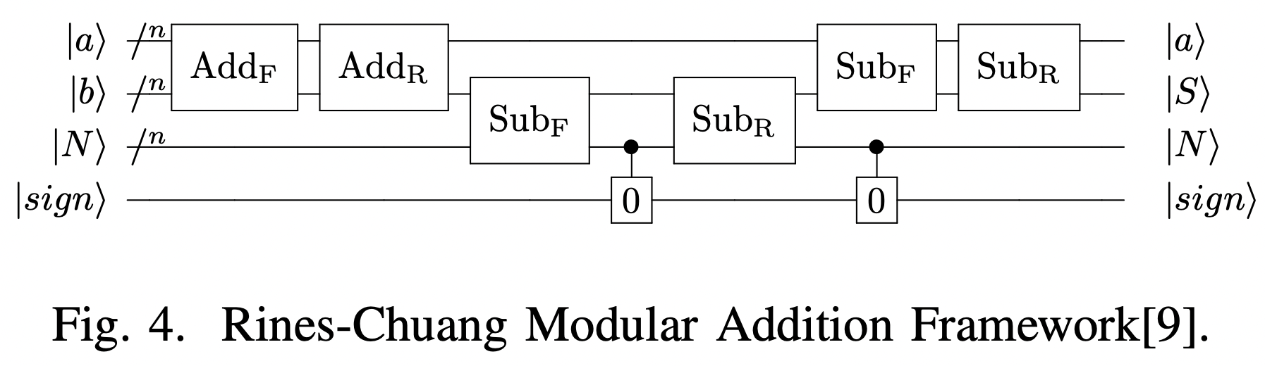
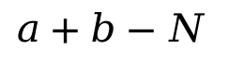
Contribution 1
Highlight the Potential of the Carry-save Architecture
VBE Modular Addition Framework^{[2]}
Beckman Modular Addition Framework^{[3]}
Van Meter Modular Addition Framework^{[4]}
Rines-Chuang Modular Addition Framework^{[5]}
$$a+b−N$$

Slide 7
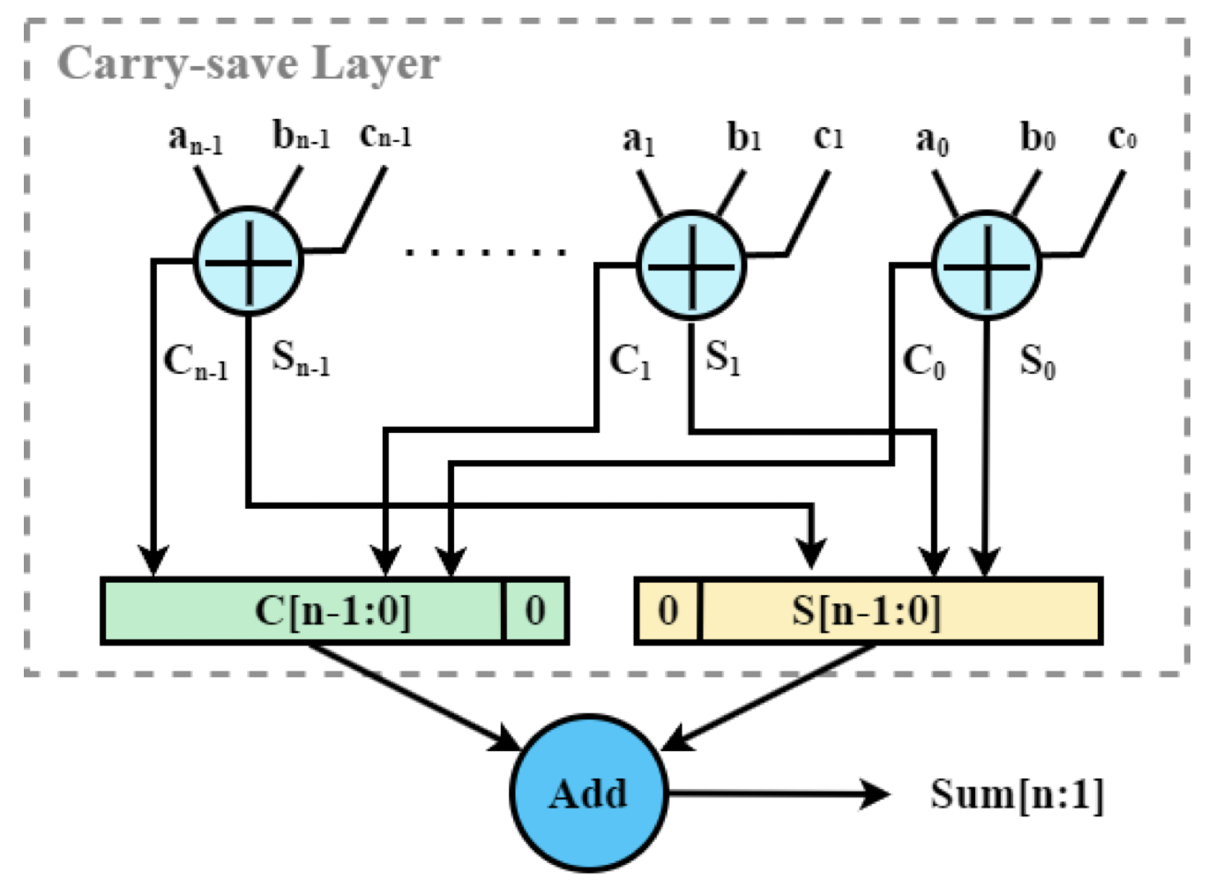
Contribution 2
Propose a Novel Modular Addition Framework based on Carry-save Architecture.
Carry Save Structure
High-Speed, Low-Cost with Low Latency
Minimizes delay by avoiding the need for immediate carry propagation.
Efficient Multi-Operand Addition
Reduces the time required for multi-operand additions.
Contribution 3
Accelerate Shor’s algorithm through improving modular addition efficiency.

Slide 8
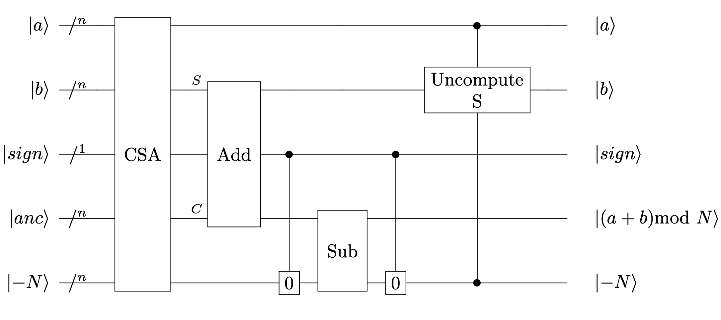
Method
Proposed Modular Addition Framework
CSA Module
Uncompute S Module
Set 0 Module
Add Module
Sub Module

Slide 9
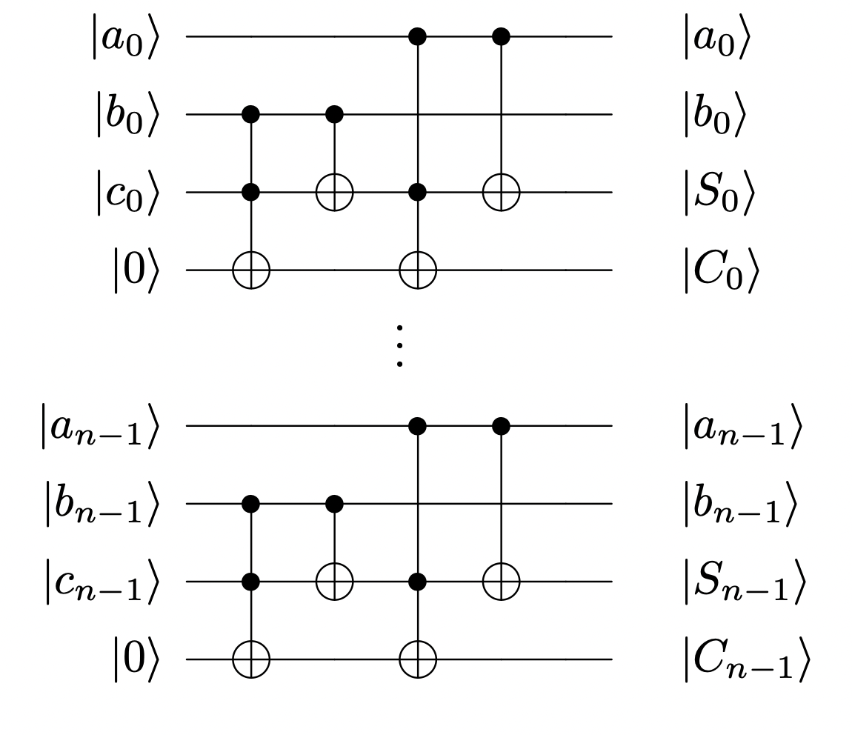
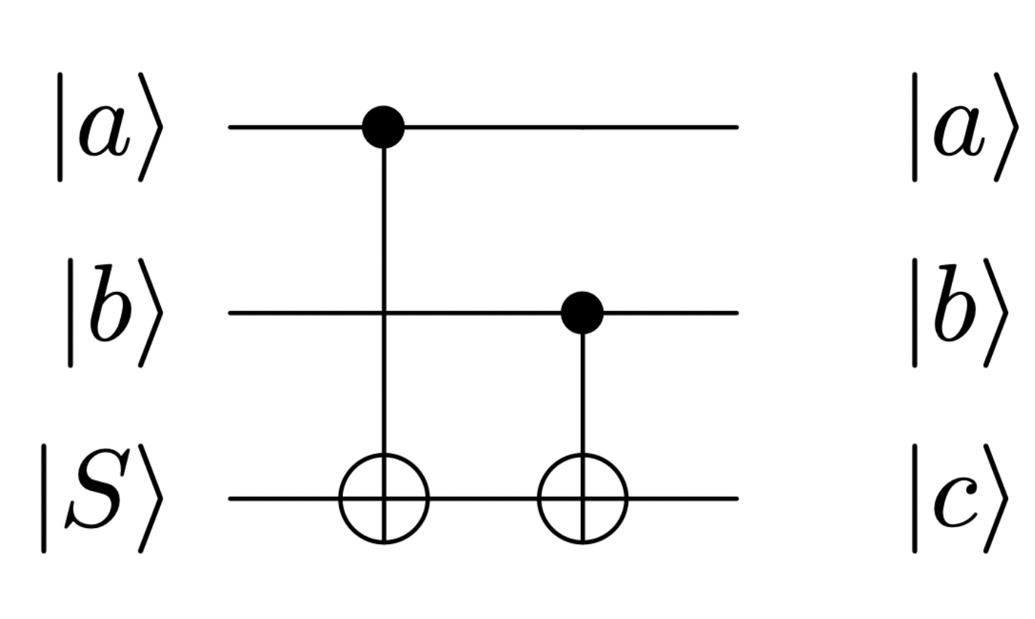
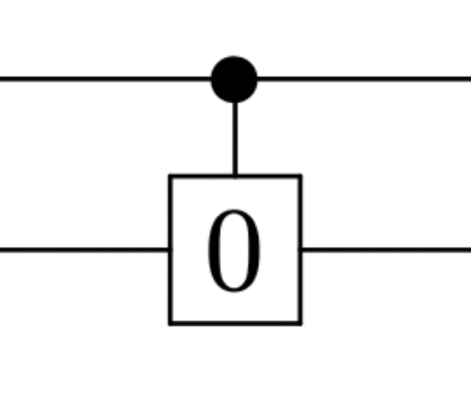
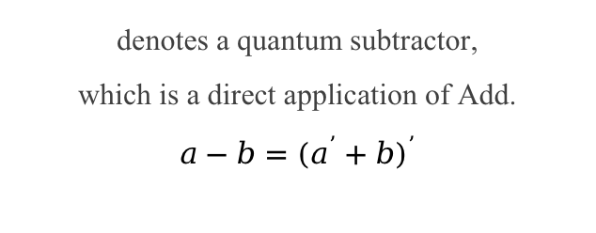
Method
Main Modules
Add Module
Sub Module
represents a quantum adder.
There are various quantum adders.
denotes a quantum subtractor,
which is a direct application of Add.
$$a−b={(a^{’}+b)}^{’}$$
CSA Module
Uncompute S Module
Set 0 Module
represents the carry-save architecture, consisting of a series of full adders operating in parallel.
uncompute the partial sum S,
which can be achieved through CNOTs.
can be implemented using CNOTs.

Slide 10
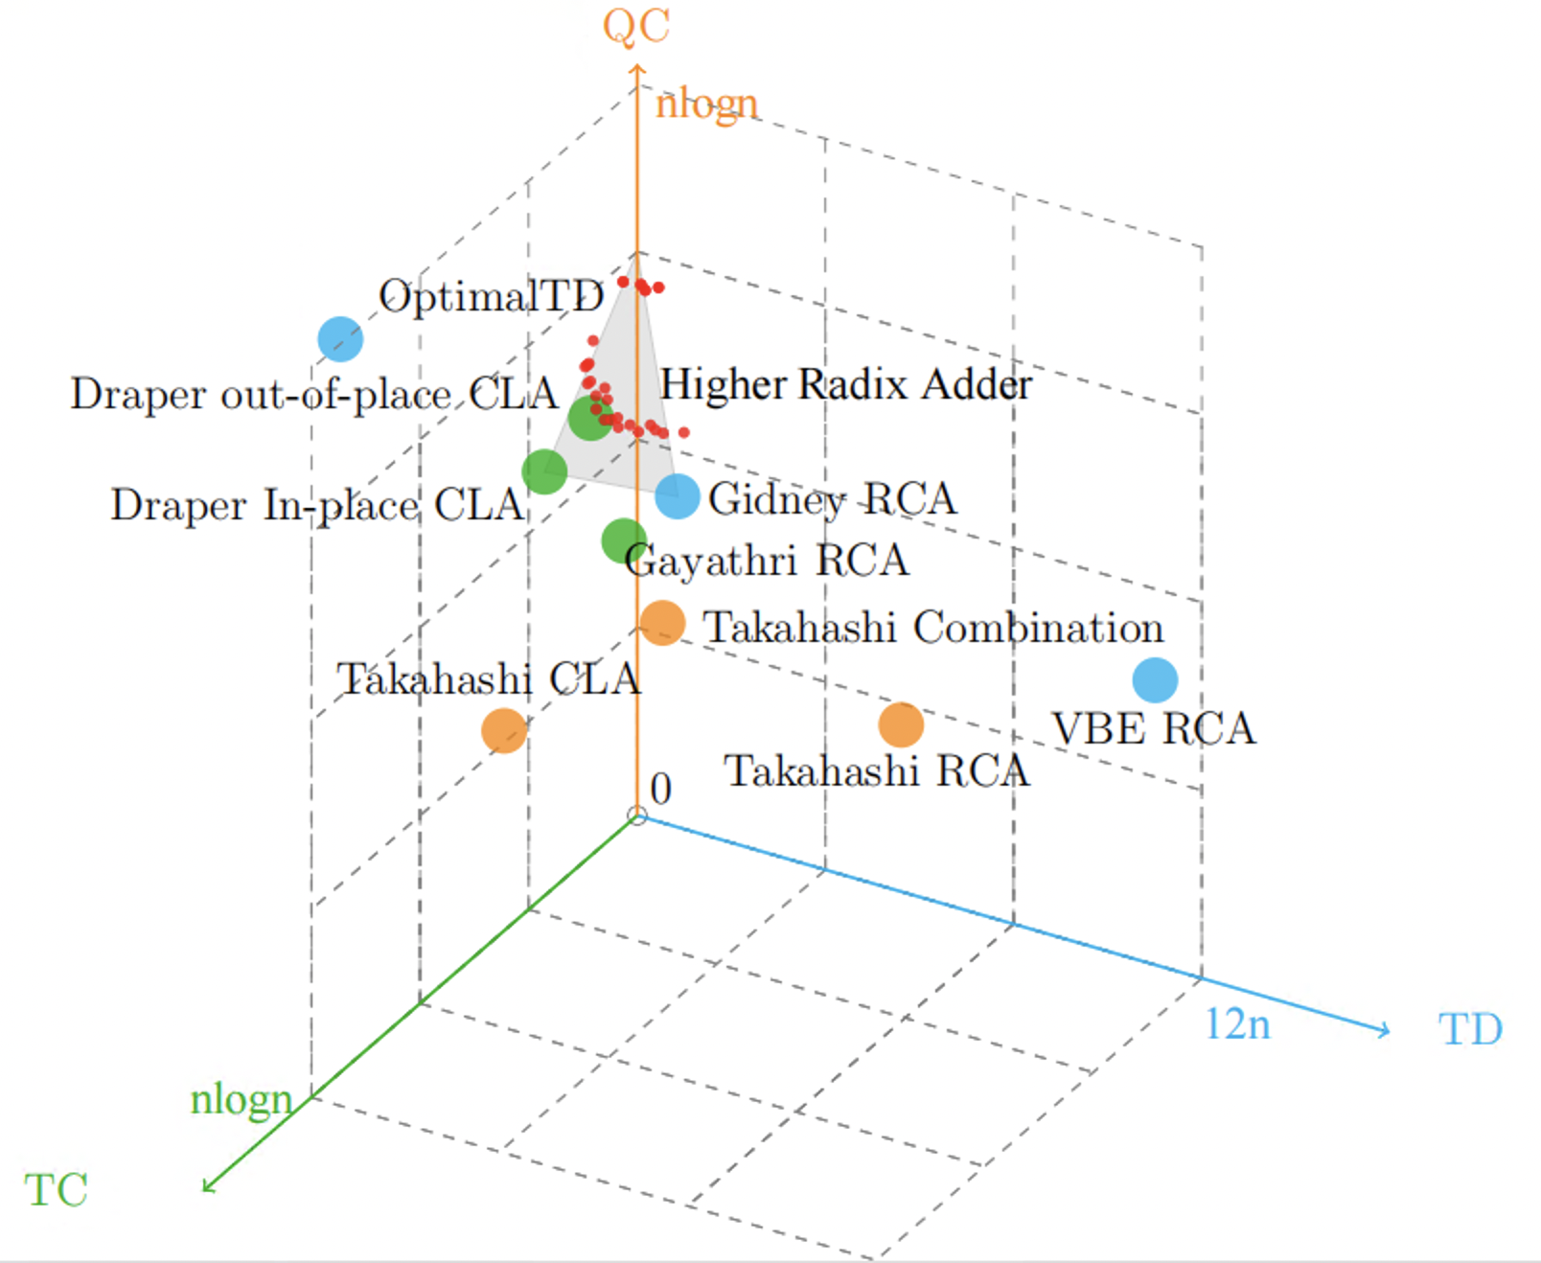
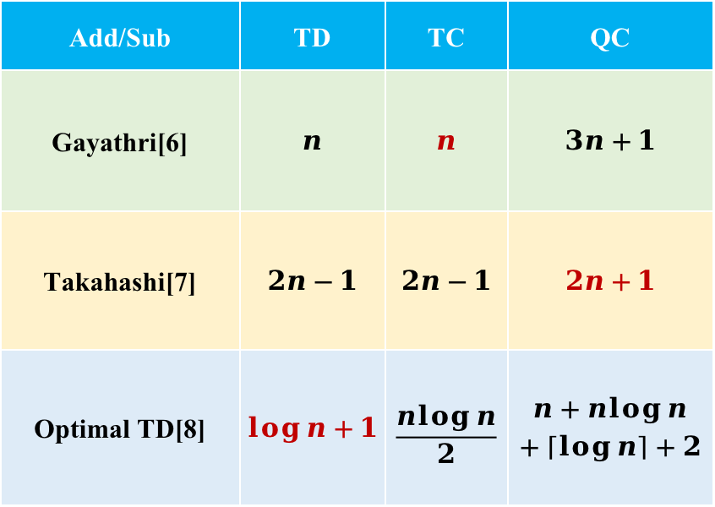
Method
Add/Sub Module
Add/Sub | TD | TC | QC
Gayathri[6] | $$n$$ | $$n$$ | $$3n+1$$
Takahashi[7] | $$2n−1$$ | $$2n−1$$ | $$2n+1$$
Optimal TD[8] | $$\log{n}+1$$ | $$\frac{n\log{n}}{2}$$ | $$n+n\log{n}$$ $$+\left\lceil \log{n}\right\rceil +2$$

Slide 11
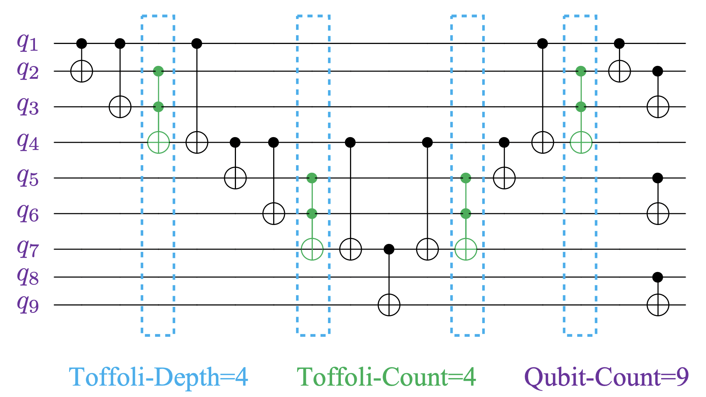
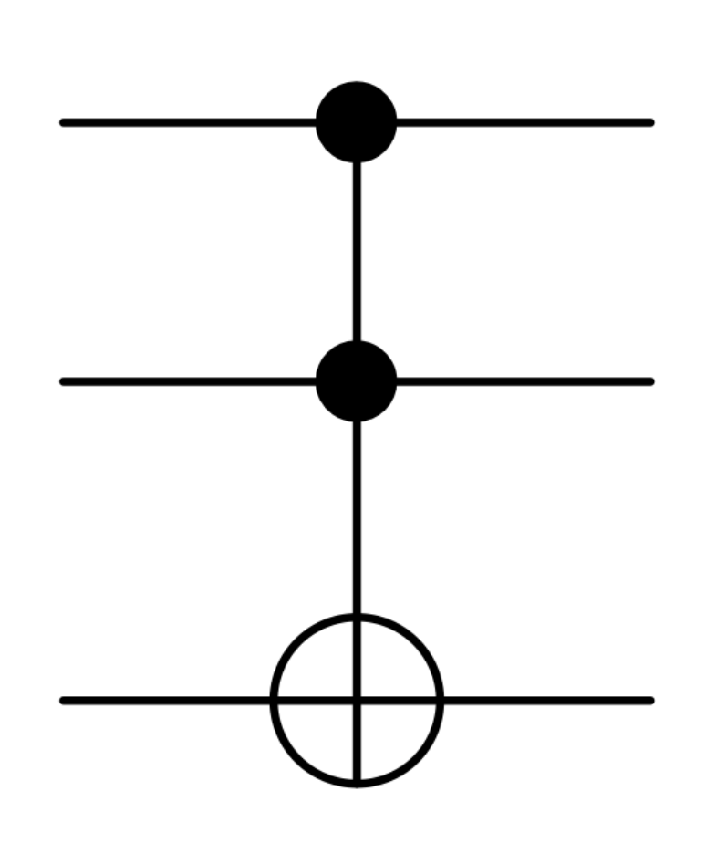
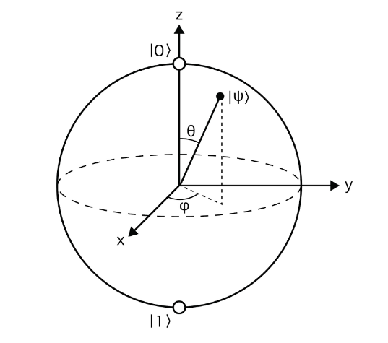
Results
Evaluation Metrics
Most Expensive Quantum Resouces
Toffoli Gate
Qubit
Toffoli-Depth (TD)
Toffoli-Count (TC)
Qubit-Count (QC)
Main
Metrics

Slide 12
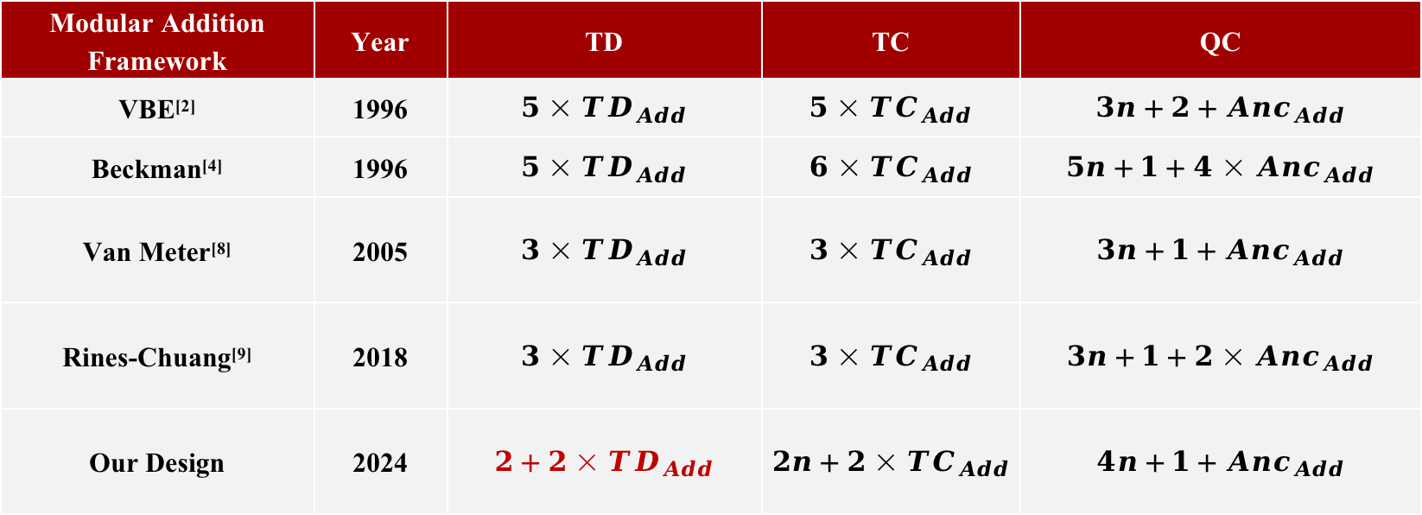
Results
Experiment 1: Comparison with Prominent Quantum Modular Addition Frameworks.
Performance Estimation of Different Quantum Modular Addition Frameworks.
Modular Addition Framework | Year | TD | TC | QC
VBE^{[2]} | 1996 | $$5×{TD}_{Add}$$ | $$5×{TC}_{Add}$$ | $$3n+2+{Anc}_{Add}$$
Beckman^{[4]} | 1996 | $$5×{TD}_{Add}$$ | $$6×{TC}_{Add}$$ | $$5n+1+{4×Anc}_{Add}$$
Van Meter^{[8]} | 2005 | $$3×{TD}_{Add}$$ | $$3×{TC}_{Add}$$ | $$3n+1+{Anc}_{Add}$$
Rines-Chuang^{[9]} | 2018 | $$3×{TD}_{Add}$$ | $$3×{TC}_{Add}$$ | $$3n+1+{2×Anc}_{Add}$$
Our Design | 2024 | $$2+2×{TD}_{Add}$$ | $$2n+2×{TC}_{Add}$$ | $$4n+1+{Anc}_{Add}$$
Theoretically, our design achieves the lowest TD

Slide 13
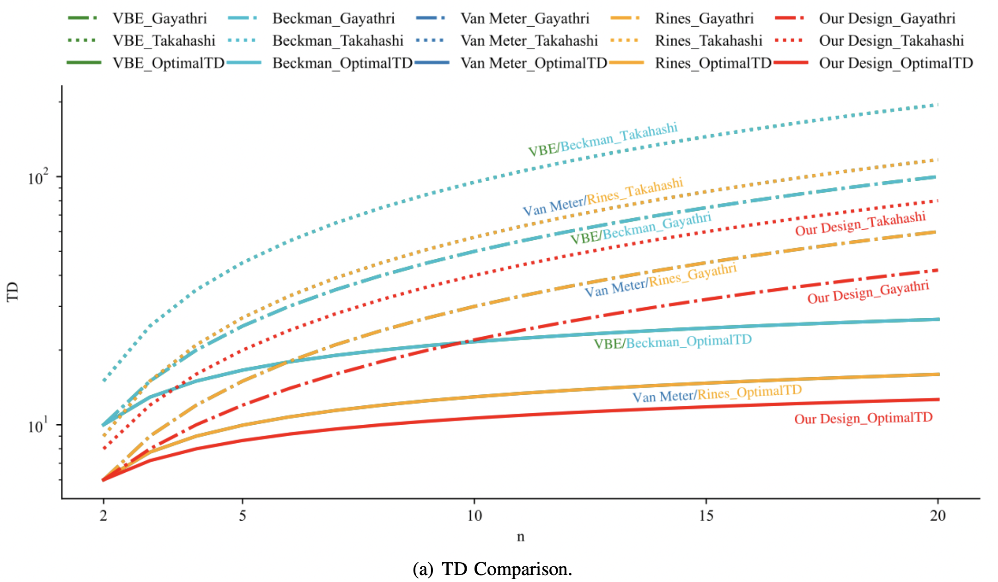
Results
Experiment 1
Our Design_Takahashi
Takahashi: low QC Adder
Our Design_Gayathri
Gayathri: low TC Adder
Our Design_OptimalTD
OptimalTD: low TD Adder
33.3%
TD Comparison
TD(Time)
Improvement

Slide 14
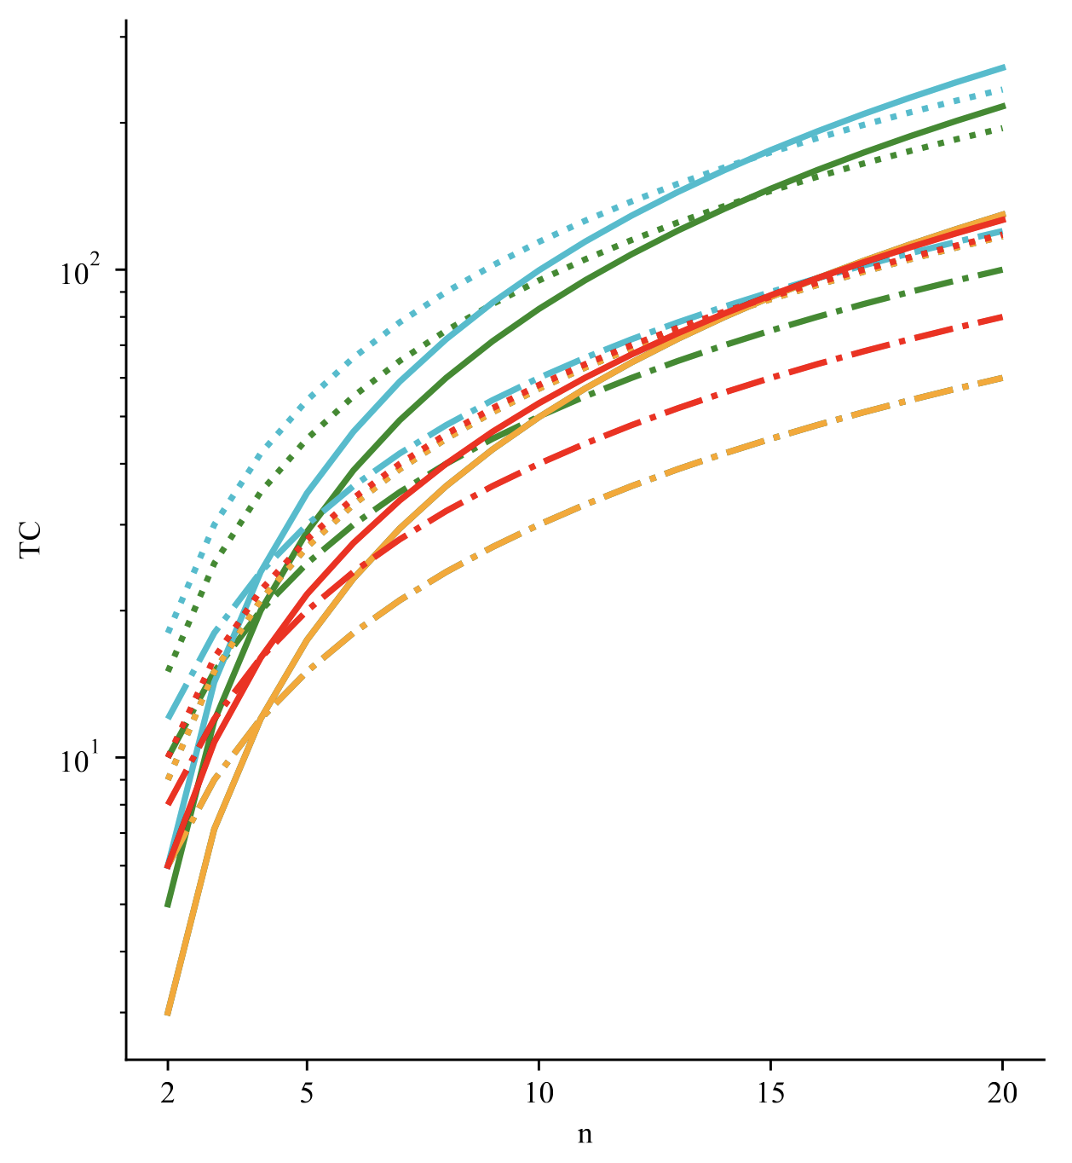
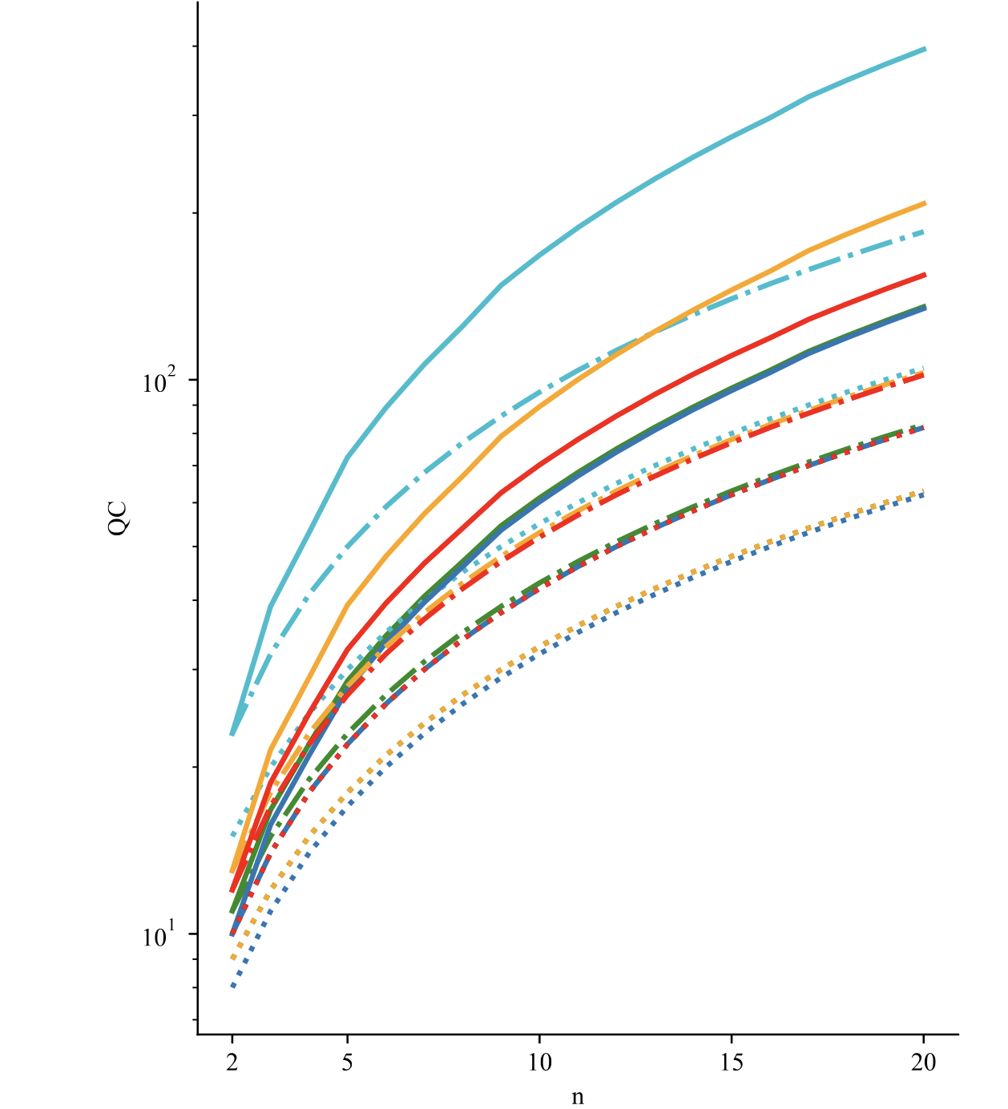
Results
Experiment 1
TC
Rines-Chuang framework with Gayathri Add achieves the lowest TC cost, with our design closely following as the second lowest.
QC
Our design exhibits a QC that falls slightly below the Beckman framework.
Discussions
The choice of Add Block and Modular Framework significantly impacts the performance of modular adders.
Our designs exhibit up to 33.3% reduction in TD, while keeping TC and QC at comparable levels.
TC Comparison
QC Comparison

Slide 15
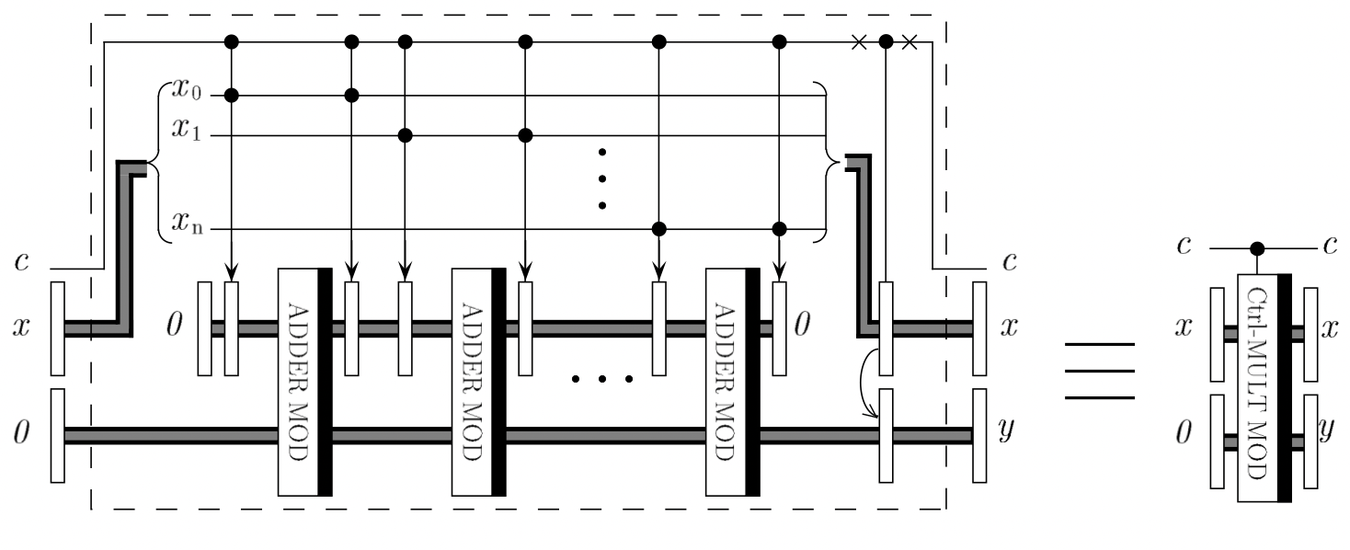
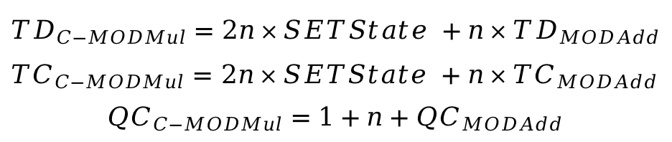
Results
Experiment 2: Influence on Quantum Modular Exponentiation
VBE Modular Multiplication Framework^{[2]}
SETState
Modular Adder
$${TD}_{C−MODMul}=2n×SETState +n×{TD}_{MODAdd}$$
${TC}_{C−MODMul}=$ $2n×SETState +n×{TC}_{MODAdd}$ $${QC}_{C−MODMul}=1+n+{QC}_{MODAdd}$$

Slide 16
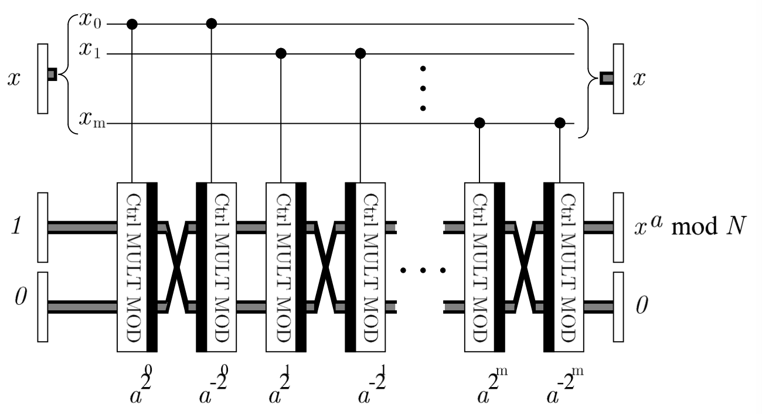
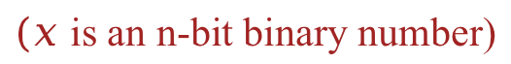
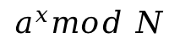
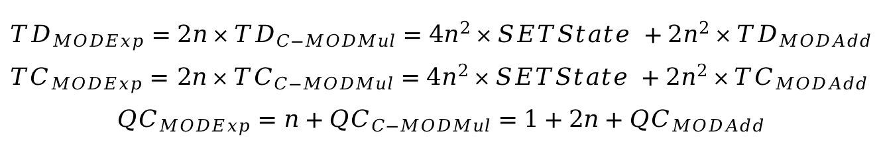
Results
Experiment 2
VBE Modular Exponentiation Framework^{[2]}
n-bit controlled modular multiplier
$$a^{x}mod N$$
$(x$ is an n-bit binary number)
60%
$${TD}_{MODExp}=2n×{TD}_{C−MODMul}=4n^{2}×SETState +2n^{2}×{TD}_{MODAdd}$$
${TC}_{MODExp}=$ $2n×{TC}_{C−MODMul}=4n^{2}×SETState +2n^{2}×{TC}_{MODAdd}$ $${QC}_{MODExp}=n+{QC}_{C−MODMul}=1+2n+{QC}_{MODAdd}$$
TD(Time)
Improvement

Slide 17

Conclusion
In this paper, we focused on exploring innovative designs to enhance the efficiency of quantum modular addition.
33.3%
1
Highlight the potential of carry-save architecture by enhancing the performance of quantum arithmetic designs.
Improve TD (Time) of
Quantum Modular Framework
2
Reduce the depth of quantum modular addition by proposing a novel framework based on carry-save architecture.
60%
3
Accelerate Shor’s algorithm through improving quantum modular addition efficiency.
Improve TD(Time) of
Quantum Exponentiation

Slide 18








IFIP/IEEE International Conference on Very Large Scale Integration
(VLSI-SoC 2024) Oct 6-9, 2024, Tanger, Morocco
Thank You for Listening!
Manuscript
LinkedIn

Slide 19
Q&A

Slide 20
References
[1] Shor, P.W., 1999. Polynomial-time algorithms for prime factorization and discrete logarithms on a quantum computer. SIAM review, 41(2), pp.303-332.
[2] Vedral, V., Barenco, A. and Ekert, A., 1996. Quantum networks for elementary arithmetic operations. Physical Review A, 54(1), p.147.
[3] Beckman, D., Chari, A.N., Devabhaktuni, S. and Preskill, J., 1996. Efficient networks for quantum factoring. Physical Review A, 54(2), p.1034.
[4] Van Meter, R. and Itoh, K.M., 2005. Fast quantum modular exponentiation. Physical Review A—Atomic, Molecular, and Optical Physics, 71(5), p.052320.
[5] Rines, R. and Chuang, I., 2018. High performance quantum modular multipliers. arXiv preprint arXiv:1801.01081.
[6] Gayathri, S.S., Kumar, R., Dhanalakshmi, S., Kaushik, B.K. and Haghparast, M., 2021. T-count optimized wallace tree integer multiplier for quantum computing. International Journal of Theoretical Physics, 60(8), pp.2823-2835.
[7] Takahashi, Y., Tani, S. and Kunihiro, N., 2009. Quantum addition circuits and unbounded fan-out. arXiv preprint arXiv:0910.2530.
[8] Wang, S., Deb, S., Mondal, A. and Chattopadhyay, A., 2024. Optimal Toffoli-Depth Quantum Adder. arXiv preprint arXiv:2405.02523.

